Slide 1


Jonas Hubmann
02.10.2022

Slide 2

Outline
Executive Summary
Introduction
Methodology
Results
Conclusion
Appendix

Slide 3
Executive Summary
Summary of methodologies
Data Collection via API, data extraction from websites (Web Scraping)
Cleaning, restructuring and enriching data trough Data Wrangling
Exploratory Data Analysis (EDA) with SQL and with Visualization
Data Visualization with Folium (Interactive Map, Dashboard)
Dashboards with Plotly Dash
Predictive Analysis
Summary of all results
Exploratory Data Analysis results
Interactive maps and dashboard
Predictive results

Slide 4
Executive Summary
Project background and context:
The aim of this project is to predict if the Falcon 9 first stage will successfully land.
SpaceX says on its website that the Falcon 9 rocket launch costs 62 million dollars which is significantly lower than other providers.
This project determines if the stage will land successfully or not and therefore can predict the cost of a launch.
The data-driven insights are mainly valuable for competitors of SpaceX.
Problems to be answered:
What are the main characteristics of a successful or failed landing?
What are the effects of each relationship of the rocket variables on the success or failure of a landing?
What are the conditions which will allow SpaceX to achieve the best landing success rate?

Slide 5

Section 1

Slide 6
Methodology
Executive Summary
Data collection methodology:
SpaceX REST API
Web Scrapping from Wikipedia
Perform data wrangling
Dropping unnecessary columns
One Hot Encoding for classification models
Perform exploratory data analysis (EDA) using visualization and SQL
Perform interactive visual analytics using Folium and Plotly Dash
Perform predictive analysis using classification models
How to build, tune, evaluate classification models

Slide 7
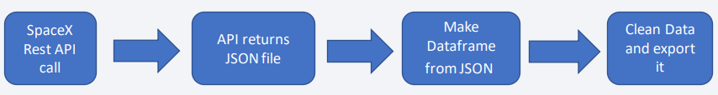
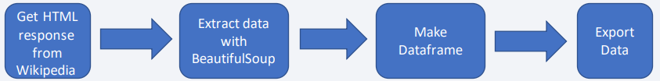
Data Collection
Datasets are collected from Rest SpaceX API and webscrapping Wikipedia:
The information obtained by the API are rocket, launches, payload information: The Space X REST API URL is api.spacexdata.com/v4/
The information obtained by the webscrapping of Wikipedia are launches, landing, payload information: URL is https://en.wikipedia.org/w/index.php?title=List_of_Falcon_9_and_Falcon_Heavy_launches&oldid=1027686922

Slide 8
Data Collection – SpaceX API
The data collection with SpaceX REST calls has been done in seven main steps.
The data response from the API has been transformed into a pandas dataframe to better clean and filter it.
To get more information enter the completed SpaceX API calls notebook via GitHub here.
Get Response from REST API
Convert Response to JSON
Transform Data
Create Dictionary with Data
Create Dataframe
Filter Dataframe
Export to File

Slide 9
Data Collection - Scraping
The data collection with Web Scraping has been done in eight main steps.
This time the Falcon 9 launch records HTML table has been extracted from Wikipedia and after parsing converted into a Pandas data frame.
To get more information enter the completed SpaceX API calls notebook via GitHub here.
Get Response from HTML
Create BeatifulSoup Object
Find all the tables
Create Dictionary
Add data to keys
Create dataframe from Dictionary
Get all column names
Export to file

Slide 10
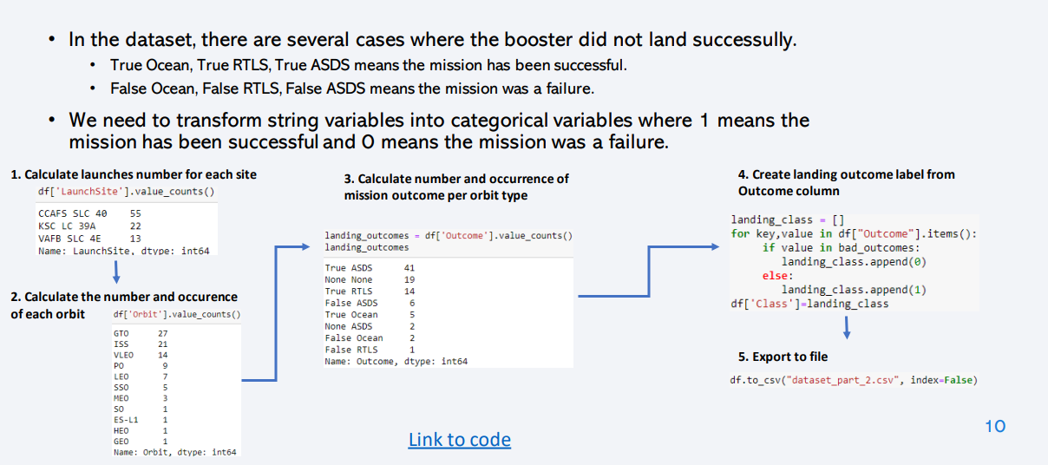
Data Wrangling
URL to GitHub

Slide 11
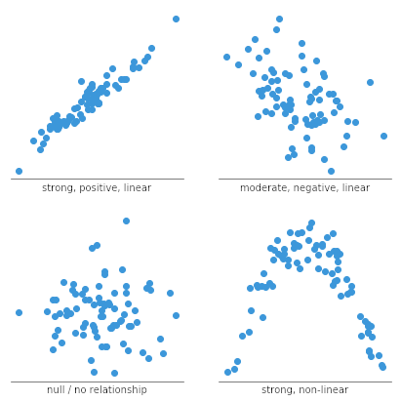
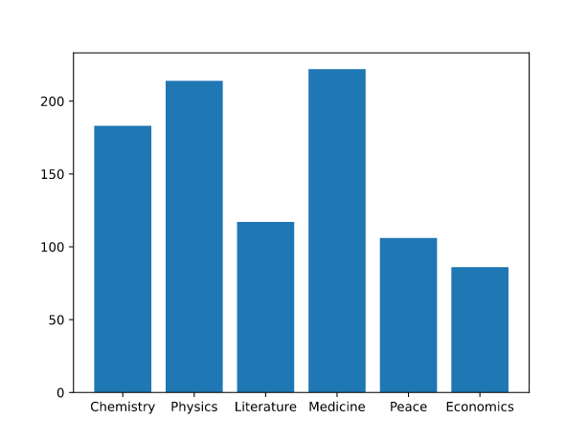
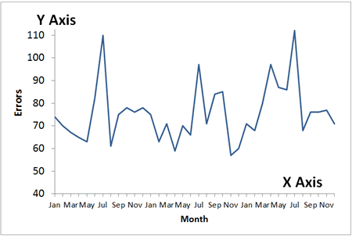
URL to GitHub
EDA with Data Visualization
Scatter plots are used to show relationship between variables. This relationship is called the correlation.
Example: Correlation between the Payload and Launch Site
Bar graphs show the relationship between numeric and categoric variables
Example: Competition of the Success rate of different Products
Line graphs show data variables and their trends. Line graphs can help to show global behavior and make prediction for unseen data.
Example: Evolution of the success rate over time

Slide 12
URL to GitHub
EDA with SQL
SQL queries to gather and understand data from dataset:
Displaying the names of the unique launch sites in the space mission.
Display 5 records where launch sites begin with the string 'CCA'
Display the total payload mass carried by boosters launched by NASA (CRS).
Display average payload mass carried by booster version F9 v1.1.
List the date when the first successful landing outcome in ground pad was achieved.
List the names of the boosters which have success in drone ship and have payload mass greater than 4000 but less than 6000.
List the total number of successful and failure mission outcomes.
List the names of the booster versions which have carried the maximum payload mass.
List the records which will display the month names, failure landing outcomes in drone ship, booster versions, launch site for the months in year 2015.
Rank the count of successful landing outcomes.

Slide 13
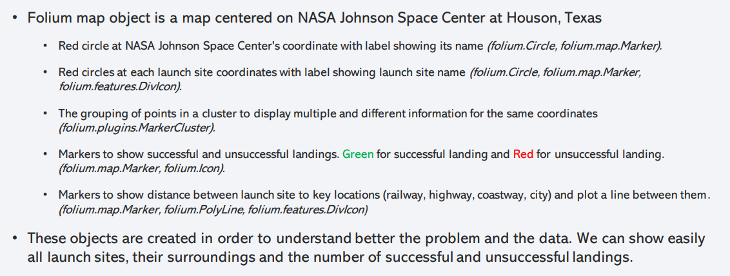
URL to GitHub
Build an Interactive Map with Folium

Slide 14
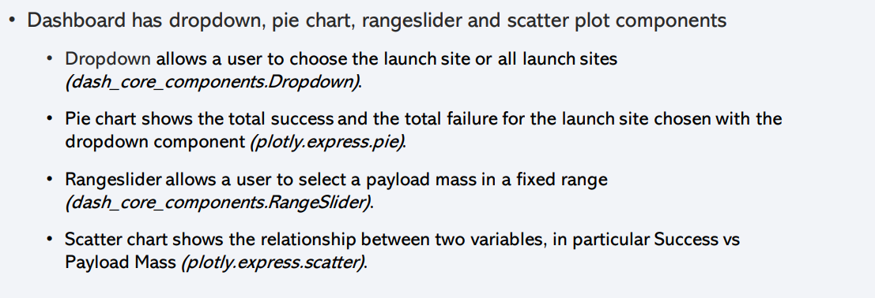
URL to GitHub
Build a Dashboard with Plotly Dash

Slide 15
URL to GitHub
Predictive Analysis (Classification)
Data preparation:
Load dataset
Normalize data
Split data into training and test sets.
Model preparation
Selection of machine learning algorithms
Set parameters for each algorithm to GridSearchCV
Training GridSearchModel models with training dataset
Model evaluation
Get best hyperparameters for each type of model
Compute accuracy for each model with test dataset
Plot Confusion Matrix
Model comparison
Comparison of models according to their accuracy
The model with the best accuracy will be chosen (see Notebook for result)

Slide 16
Results
Exploratory data analysis results
Interactive analytics demo in screenshots
Predictive analysis results

Slide 17

Section 2

Slide 18
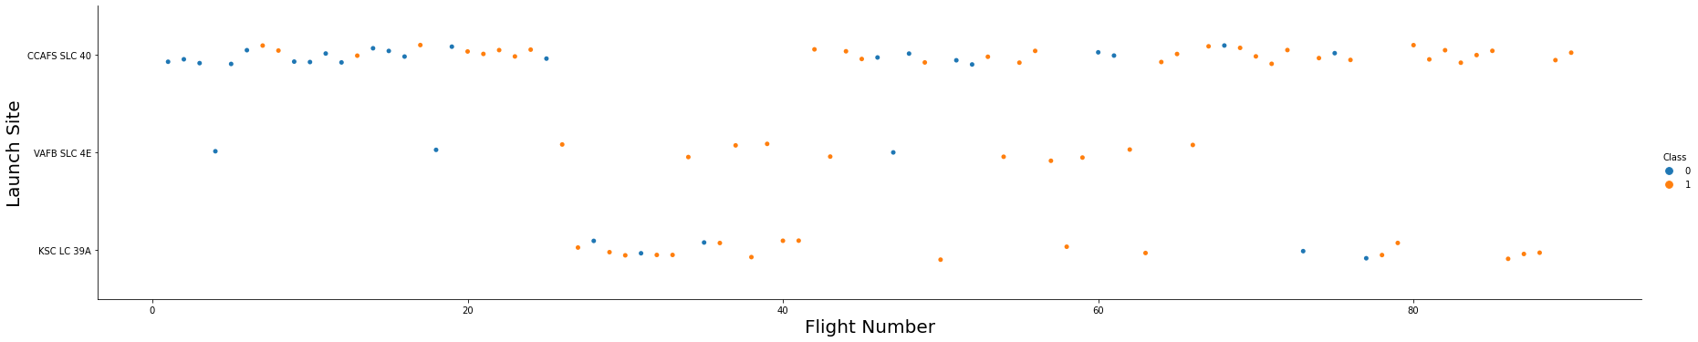
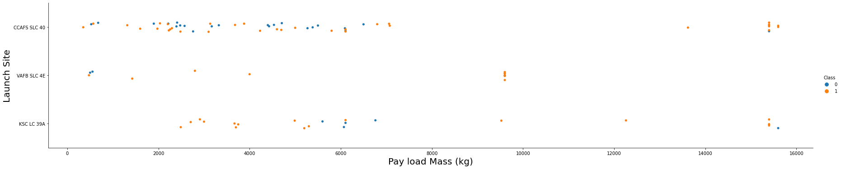
Exploratory Data Analysis
Flight Number vs. Launch Site
We observe that, for each site, the success rate is increasing.
Payload vs. Launch Site
There are no rockets launched for heavypayload mass(greater than 10000) for the VAFB-SLC launchsite.

Slide 19
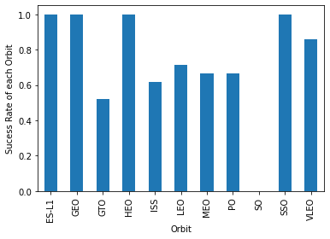
Success Rate vs. Orbit Type
We note that ES-L1, GEO, HEO, SSO have the best success rate.​

Slide 20
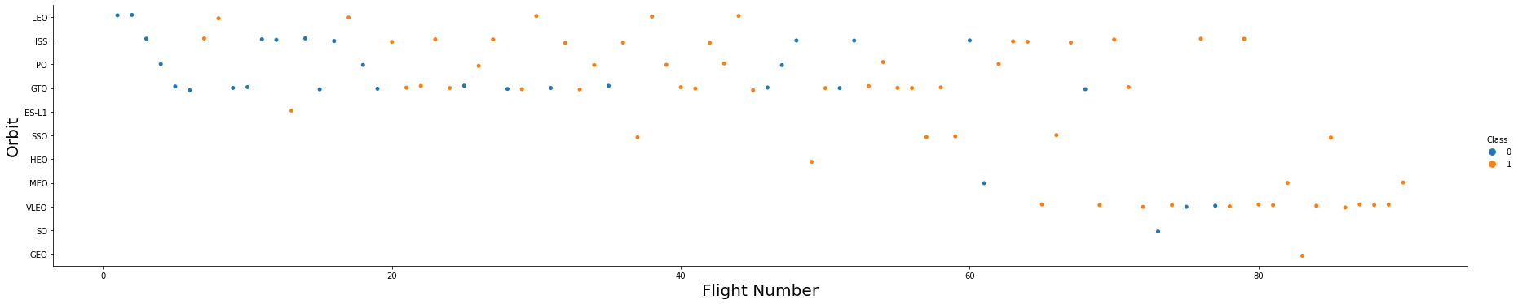
Flight Number vs. Orbit Type
In the LEO orbit the Success appears related to the number of flights; on the other hand, there seems to be no relationship between flight number when in GTO orbit.

Slide 21
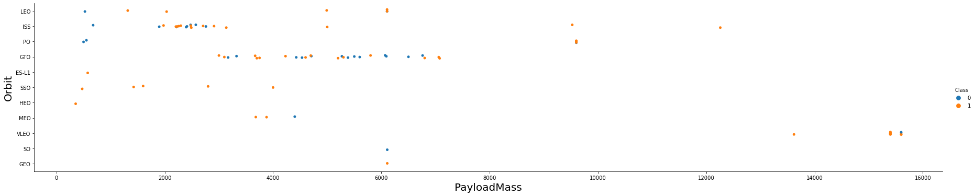
Payload vs. Orbit Type
With heavy payloads the successful landing or positive landing rate are more for Polar,LEO and ISS.
However for GTO we cannot distinguish this well as both positive landing rate and negative landing(unsuccessful mission) are both there here.

Slide 22
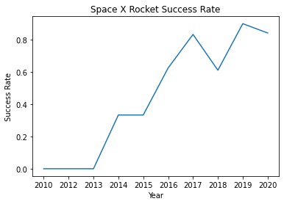
Launch Success Yearly Trend
you can observe that the success rate since 2013 kept increasing till 2020

Slide 23
All Launch Site Names
Find the names of the unique launch sites: SELECT DISTINCT "LAUNCH_SITE" FROM SPACEXTBL
Launch_Site
CCAFS LC-40
VAFB SLC-4E
KSC LC-39A
CCAFS SLC-40
The use of DISTINCT in the query allows to remove duplicate LAUNCH_SITE.

Slide 24
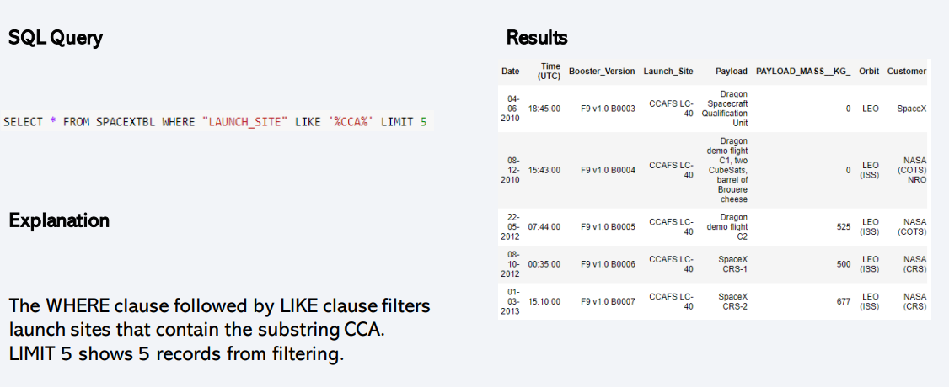
Launch Site Names Begin with 'CCA'

Slide 25
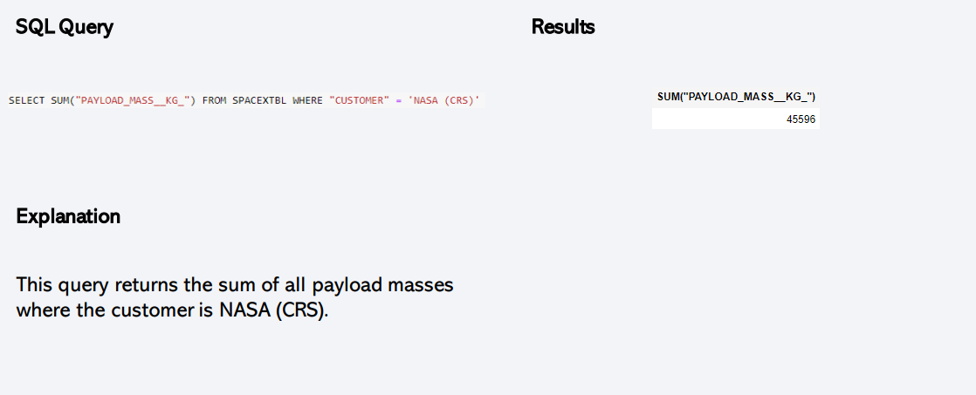
Total Payload Mass

Slide 26
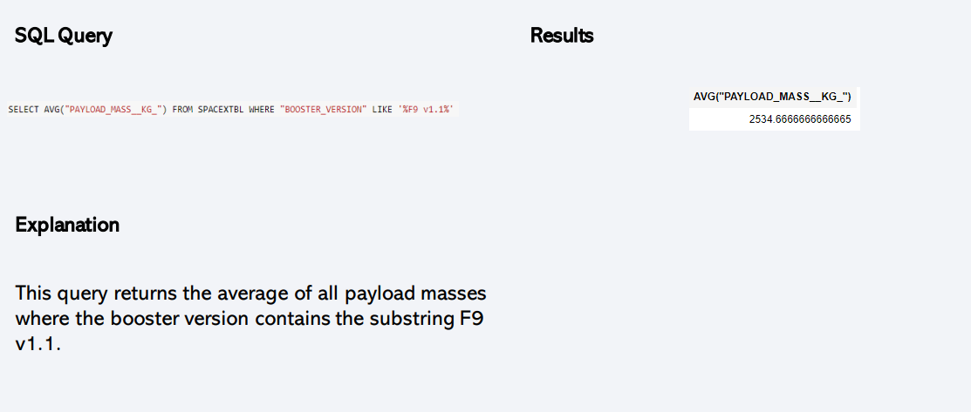
Average Payload Mass by F9 v1.1

Slide 27
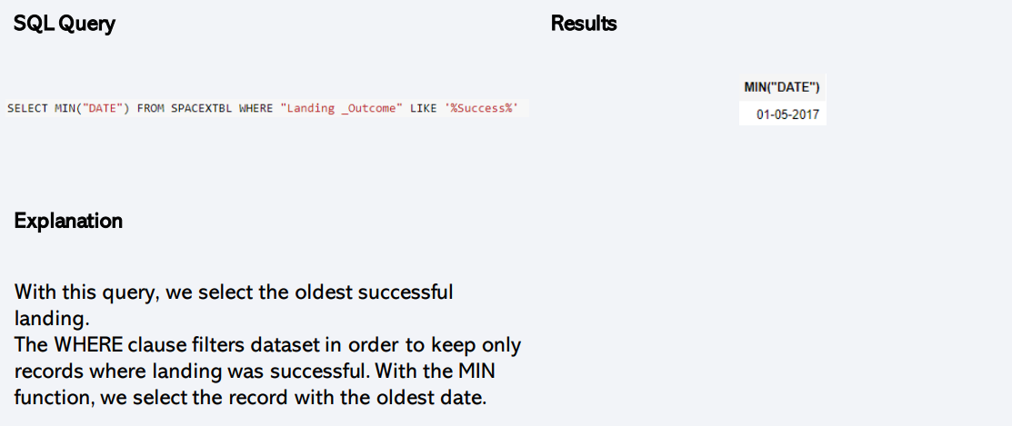
First Successful Ground Landing Date

Slide 28
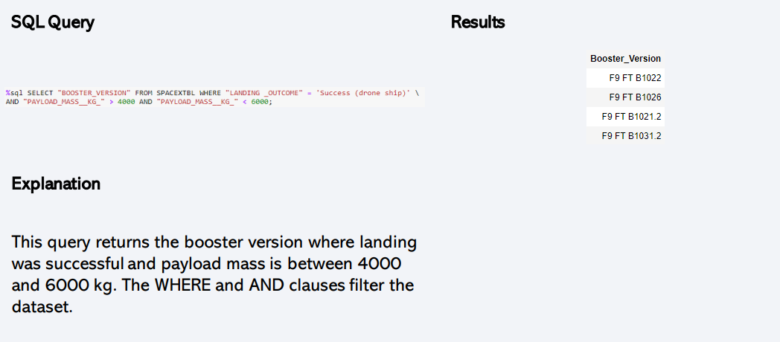
Successful Drone Ship Landing with Payload between 4000 and 6000

Slide 29
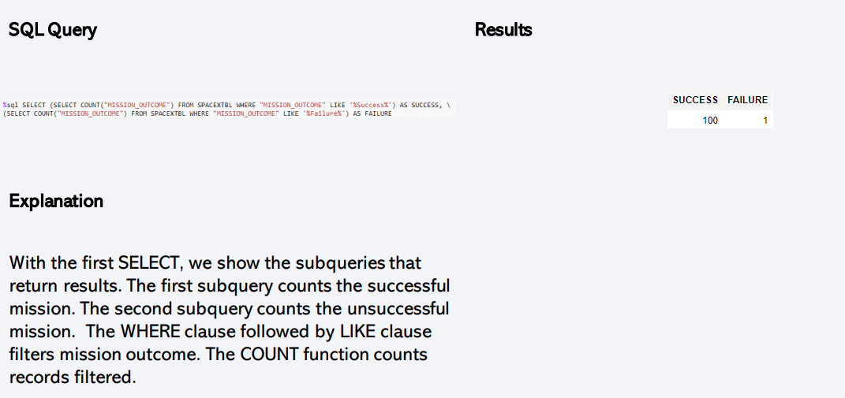
Total Number of Successful and Failure Mission Outcomes

Slide 30
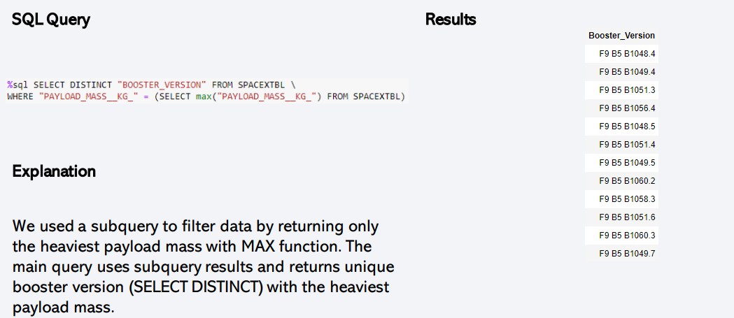
Boosters Carried Maximum Payload

Slide 31
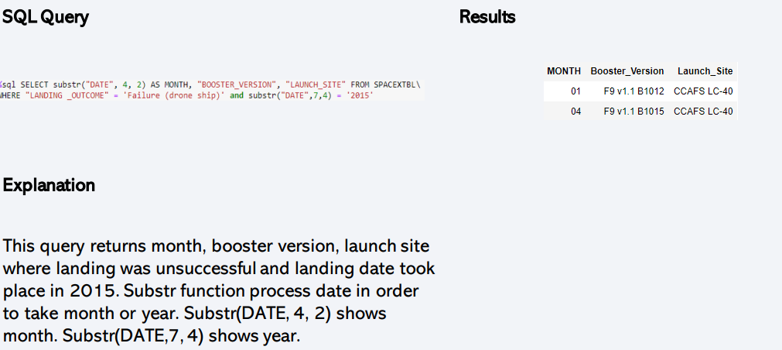
2015 Launch Records

Slide 32
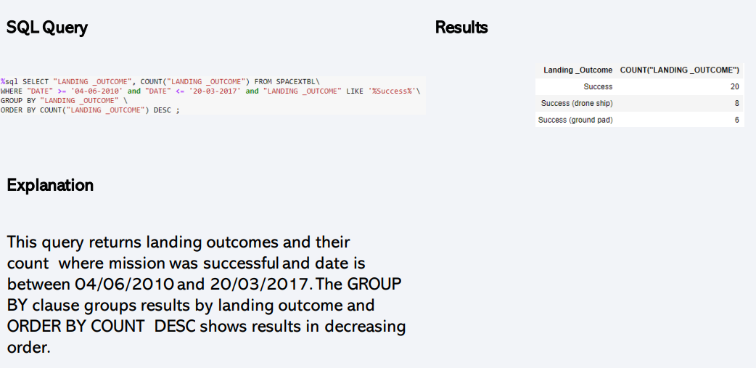
Rank Landing Outcomes Between 2010-06-04 and 2017-03-20

Slide 33

Section 3

Slide 34
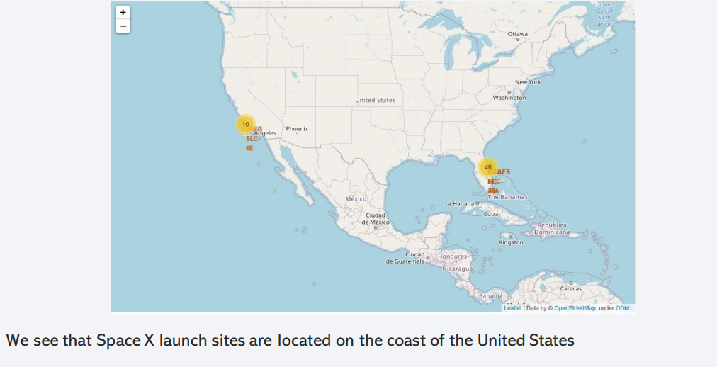
Folium Map: Space X costal launch sites

Slide 35
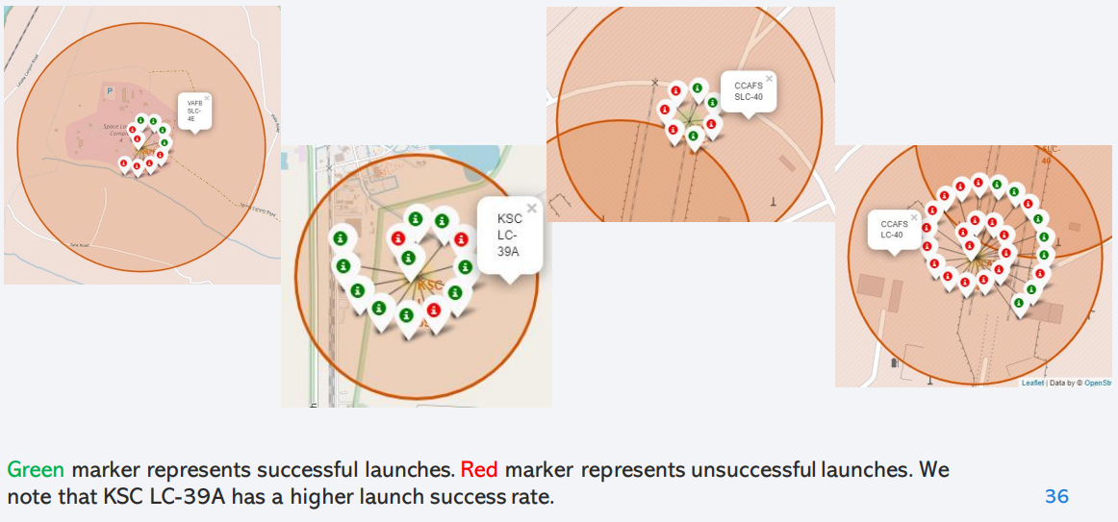
Folium Map: Successful and unsuccessful launches

Slide 36
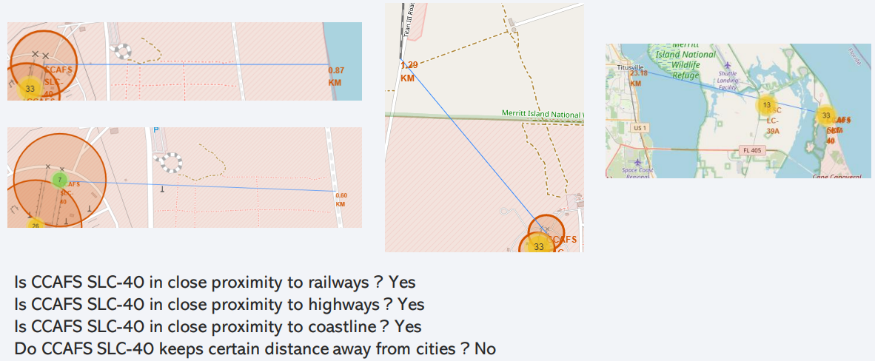
Folium Map: Visualizations of proximities

Slide 37

Section 4

Slide 38
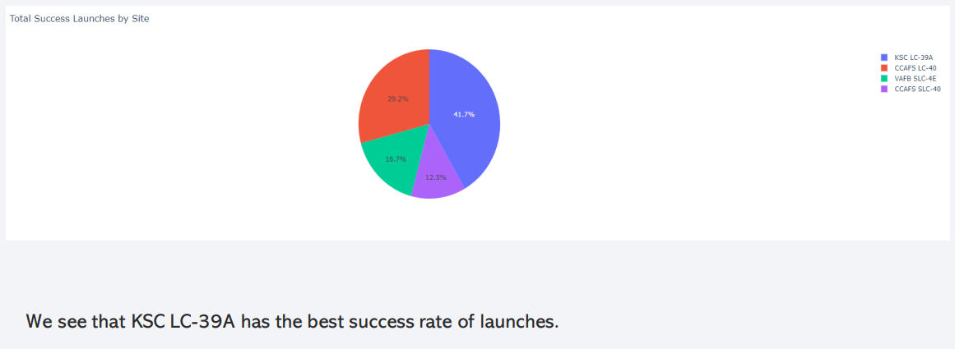
Dashboard: Success Rates of Launches

Slide 39
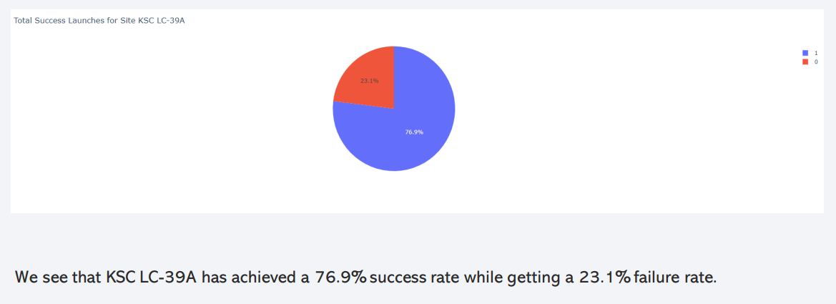
Dashboard: Success rate of KSC LC-39A

Slide 40
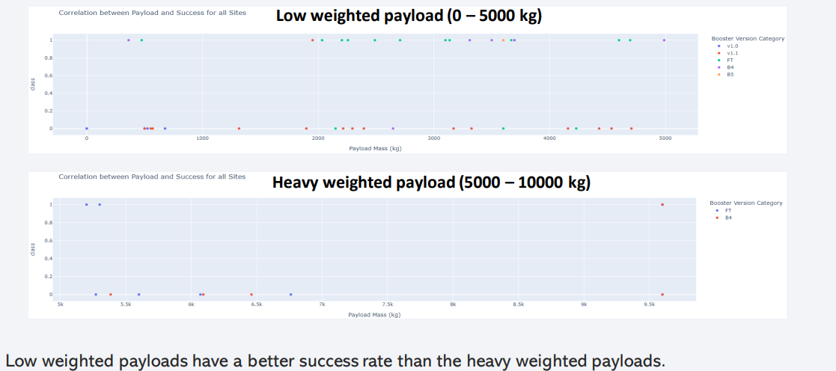
Dashboard – Payload mass vs Outcome for all sites with different payload mass selected

Slide 41

Section 5

Slide 42
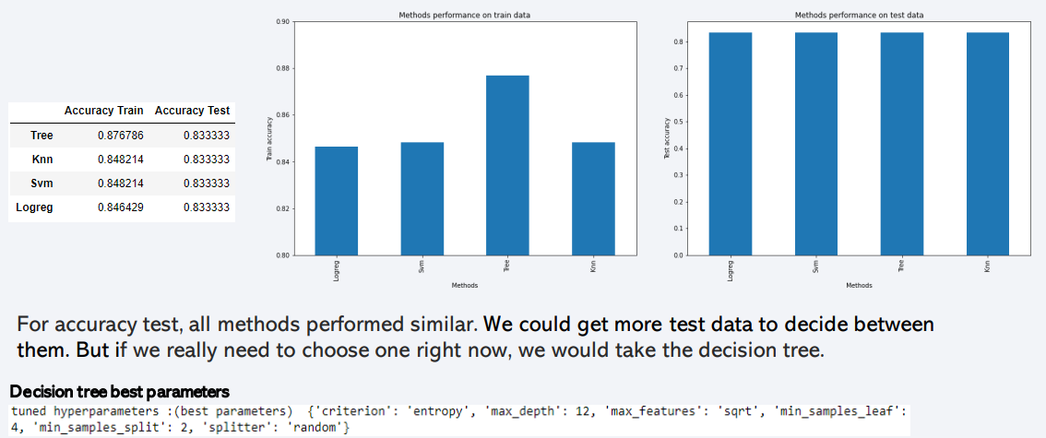
Classification Accuracy

Slide 43
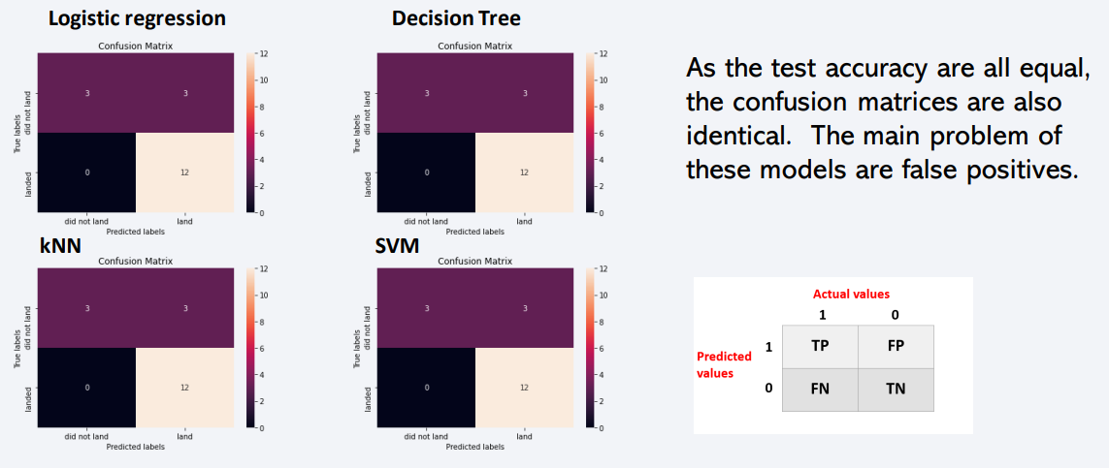
Confusion Matrix

Slide 44

Conclusions
The success of a mission can be explained by several factors such as the launch site, the orbit and especially the number of previous launches.
The orbits with the best success rates are GEO, HEO, SSO, ES-L1.
Depending on the orbits, the payload mass can be a criterion to consider for the success of a mission. Some orbits require a light or heavy payload mass. But generally low weighted payloads perform better than the heavy weighted payloads.
With the current data, we cannot explain why some launch sites are better than others (KSC LC-39A is the best launch site). To get an answer to this problem, we could obtain atmospheric or other relevant data.
For this dataset, we choose the Decision Tree Algorithm as the best model even if the test accuracy between all the models used is identical. We choose Decision Tree Algorithm because it has a better train accuracy.

Slide 45


